Slide 1
Big Mountain Resort Data Science

Slide 2
Introduction
What opportunities exist for Big Mountain to recoup the increased operational cost of $1.54 million over the next year through modification of pricing or optimization of importance of their facilities?
Big Mountain Resort currently charges a premium weekend pass of $81

Slide 3
Objective
Create a machine learning model to predict the price Big Mountain should charge depending on their place in the market

Slide 4
Data
26 descriptive features of 328 unique ski resorts
Name, region, state, summit elevation, vertical drop, trams, fast sixes, longest run etc.
Target features: AdultWeekday, AdultWeekend

Slide 5
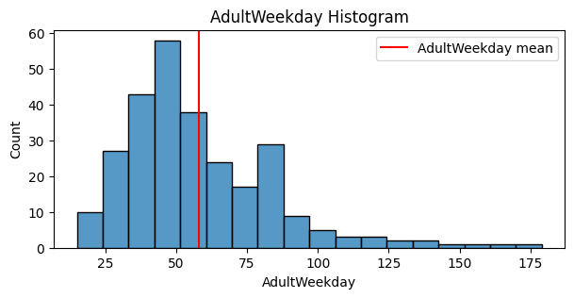
Exploratory Data Analysis
AdultWeekend is right- skewed

Slide 6
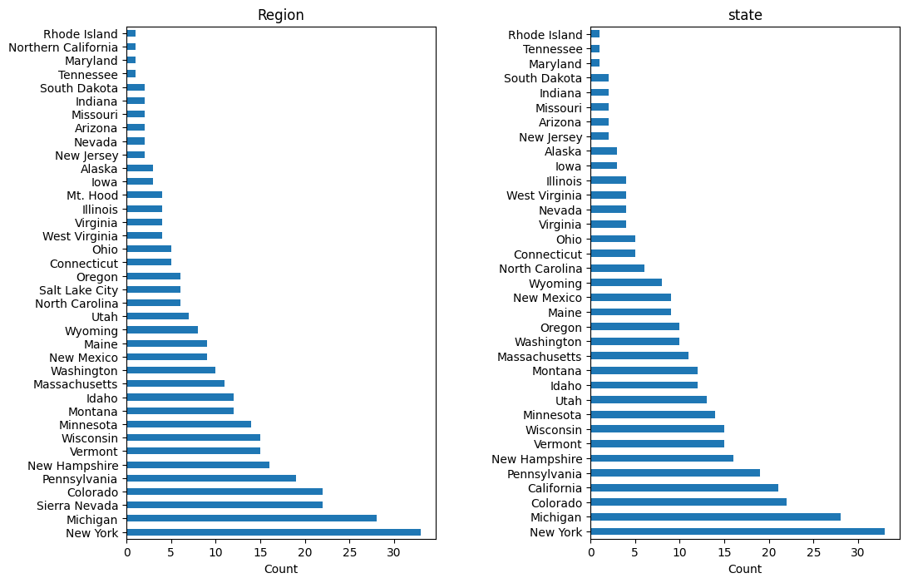
Exploratory Data Analysis
New York and Michigan are the states and regions with the most ski resorts

Slide 7
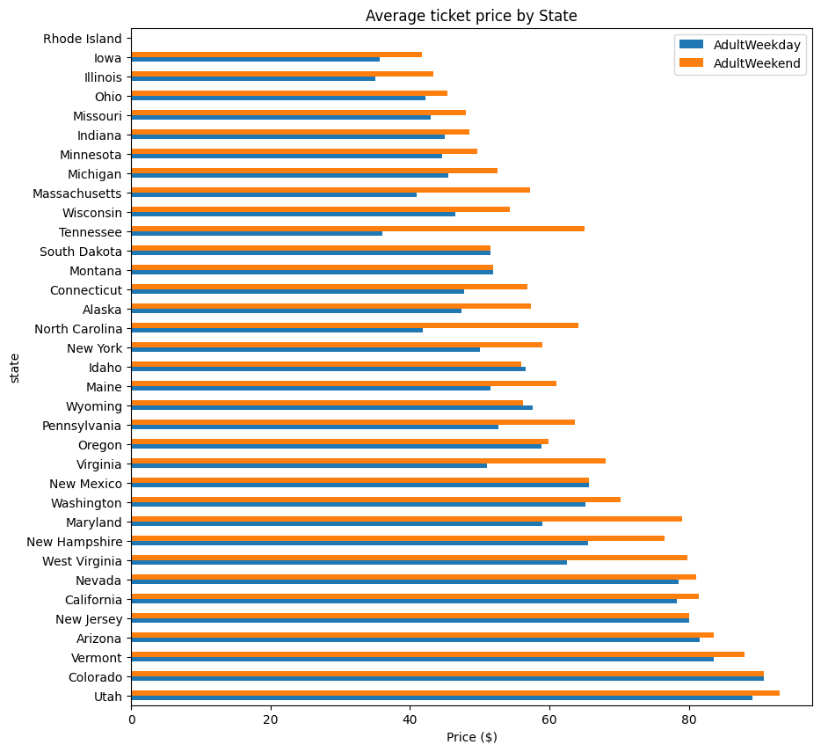
Exploratory Data Analysis
Utah, Colorado and Vermont have the highest average ticket prices

Slide 8
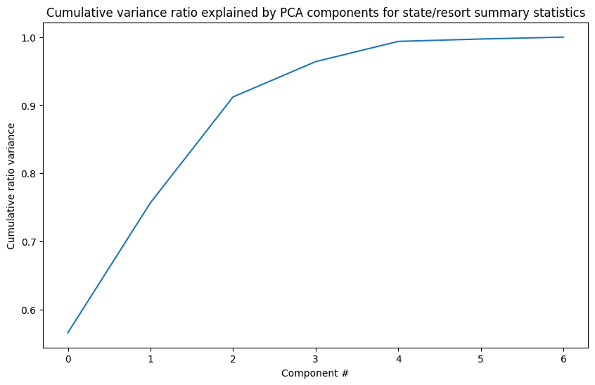
Exploratory Data Analysis
First two components account for over 75% of the variance
First four components account for over 95% of the variance

Slide 9
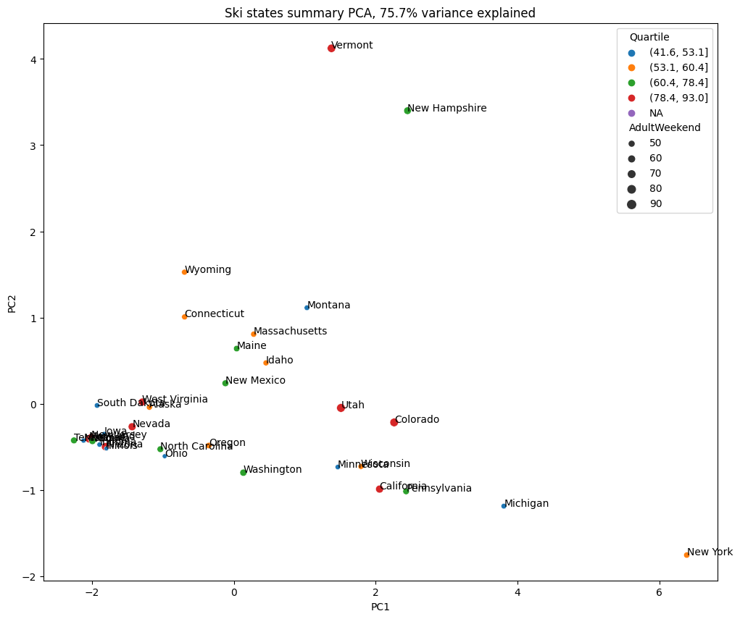
Exploratory Data Analysis
No clear pattern with distribution of states with the first two components

Slide 10
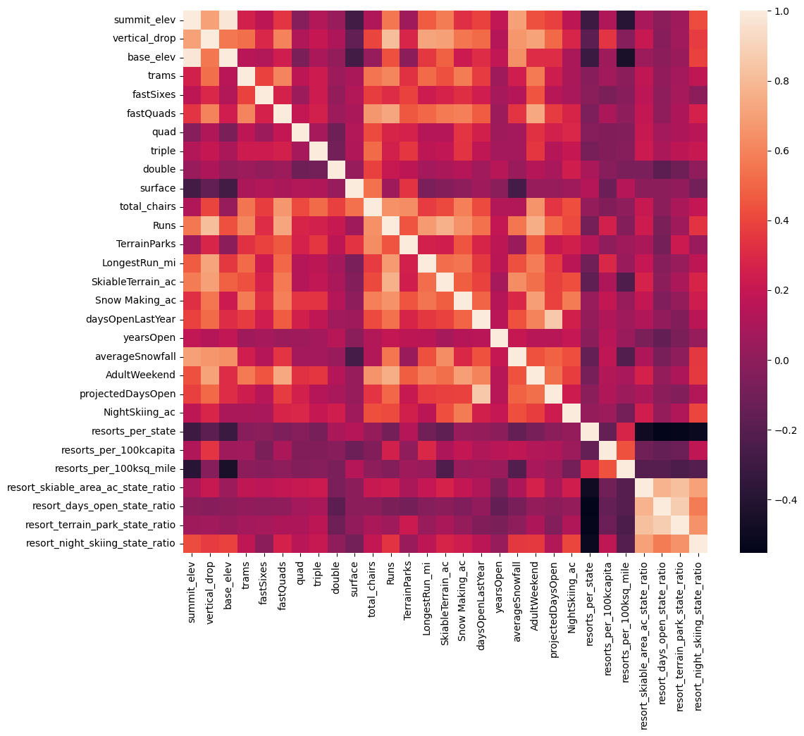
Exploratory Data Analysis
fastQuads, Runs, tota_chairs, and Snow Making_ac are strongly correlated with AdultWeekend
Resort_night_skiing_state_ratio correlated with AdultWeekend

Slide 11
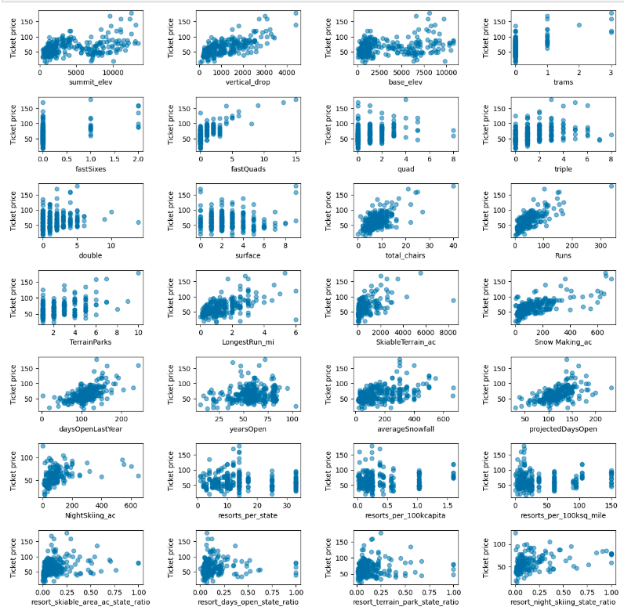
Exploratory Data Analysis
Scatter plots of features vs ticket price matches the correlation matrix

Slide 12
Preprocessing and Training
70/30 train/test split
Impute missing data with mean or median
Scale data around 0 using a standard scaler

Slide 13
Modeling: Linear Regression Model
Select k best features
R-squared score on train data: 0.72
R-squared score on test data: 0.638
MAE on train data: 9.21
MAE on test data: 10.49
CV score mean: 0.633
CV score standard deviation: 0.095

Slide 14
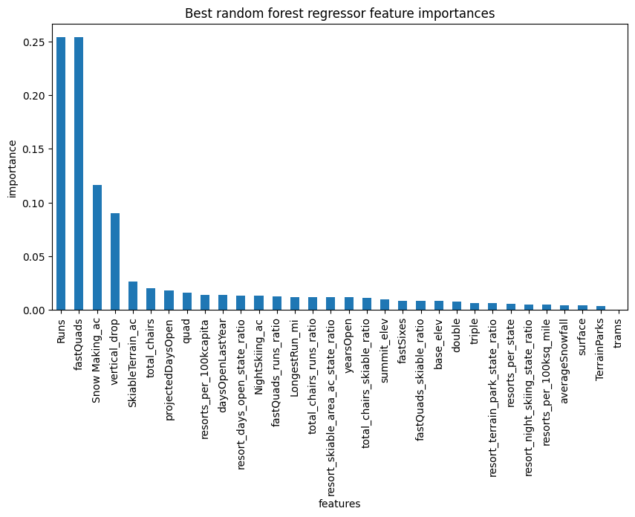
Modeling: Random Forest Regressor
CV score mean: 0.713
CV score standard deviation: 0.071
Runs and fastQuads are most important features
Snow Making_ac and vertical_drop also important
Better model than linear regression

Slide 15
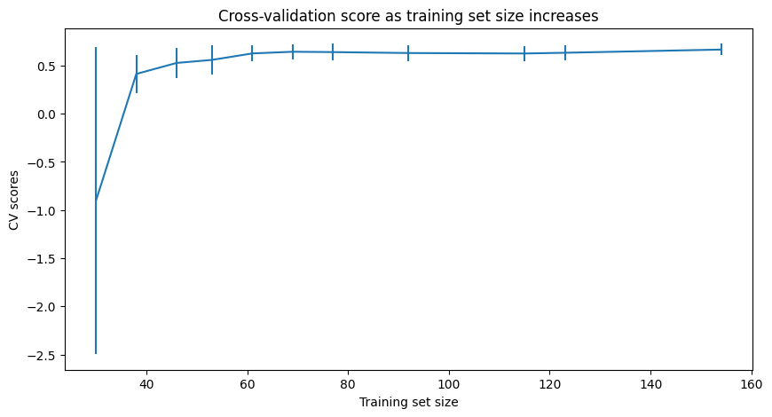
Evaluation
Cv scores level off by around 40-50 samples indicating there is sufficient data

Slide 16
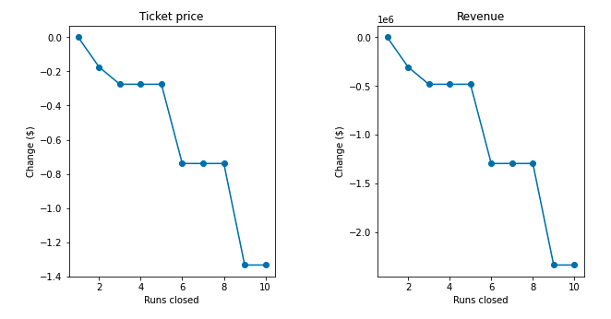
Modeling Results: Scenario 1
Close up to 10 of the least used runs
Closing one run makes no difference
Closing 2 and 3 runs reduces support for ticket price
Closing 4 or 5 runs produces the same loss in revenue as closing 3 runs
Closing 6 or more runs leads to large drop in ticket price and revenue

Slide 17
Modeling Results: Scenario 2
Add a run, increase the vertical drop by 150ft, and install a new chairlift
Increases support for an increase of ticket price by $161
Over the season, this is expected to amount to $2,815,217

Slide 18
Modeling Results: Scenario 3
Add a run, increase the vertical drop by 150ft, install a new chairlift, and add 2 acres of snow making
This scenario gives the exact same results as scenario 2
Increases support for an increase of ticket price by $161
Over the season, this is expected to amount to $2,815,217

Slide 19
Modeling Results: Scenario 4
Increase the longest run by 0.2 miles and guarantee its snow coverage by adding 4 acres of snow making capability.
This scenario resulted in making no difference

Slide 20
Conclusion
Scenario 2 yields the best results
It will allow for an increase in price that will cover the seasonal operational cost of adding the new chairlift

